Slide 1
CT3-Advanced Data Visualization
Prepared By: Lakshminathan.P
Register Number: PA2312044010046

Slide 2
1. Top N Run Scorers
Purpose: Display the top N run scorers in the IPL dataset.
Description: This dashboard showcases the top N run scorers in the history of the Indian Premier League.
Introduction to the Tableau Sheet

Slide 3
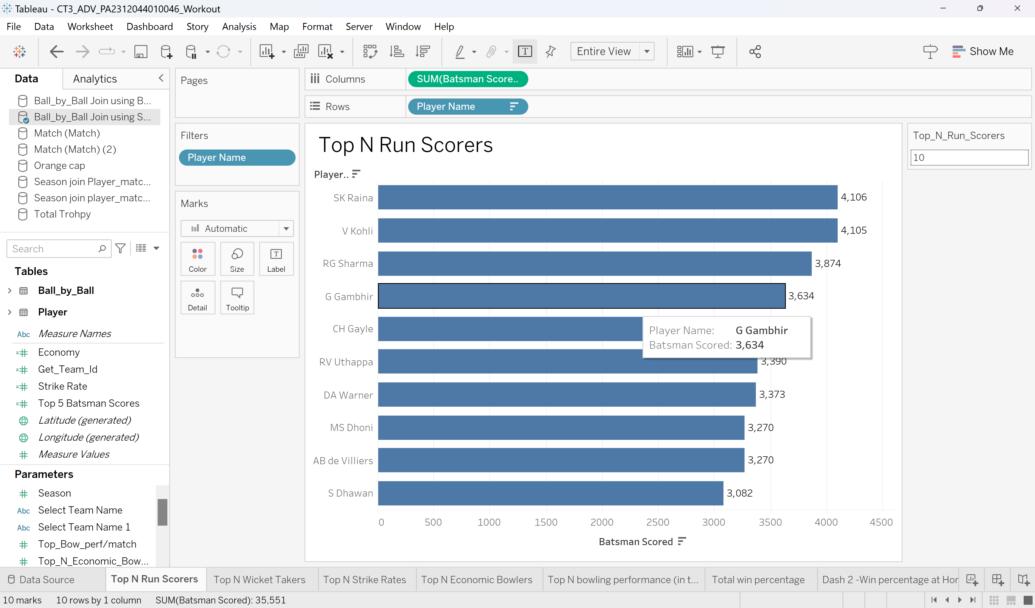
Tableau Dashboard and Parameters Control
Purpose: Display the top N run scorers in the IPL dataset.
Description: Using the parameter control, can control the number of top players to be displayed.

Slide 4
Conclusion
Insights: SK Raina is the highest run scorer in IPL history with 4106 runs.
The top run scorers have consistently performed well across multiple seasons.
Observations: Some players have shown remarkable performance consistently over multiple seasons like V_Kohli, RG Sharma, G Gambhir,..

Slide 5
2. Top N Wicket Takers
Purpose: Display the top N wicket takers in the IPL dataset.
Description: This dashboard showcases the top N wicket-takers in the history of the Indian Premier League.
Introduction to the Tableau Sheet

Slide 6
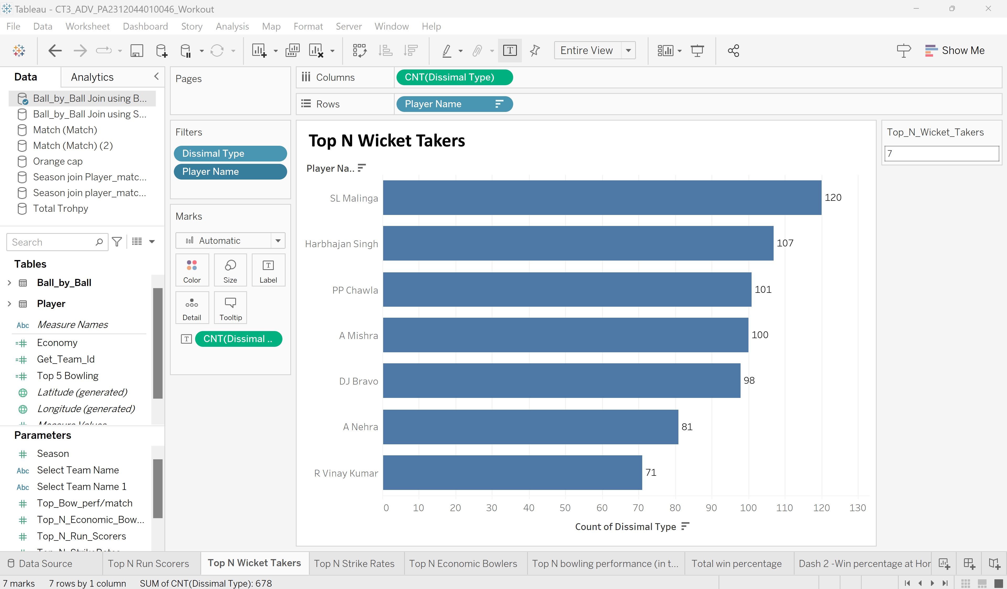
Tableau Dashboard and Parameters Control
Purpose: Display the top N wicket-takers in the IPL dataset.
Description: Using the parameter control can control the number of top wicket-takers to be displayed.

Slide 7
Conclusion
Insights: SL Malinga is the highest wicket-taker in IPL history with 120 wicket.
The top wicket-takers have consistently performed well across multiple seasons.
Observations: Some players have consistently performed remarkably over multiple seasons like Harbhajan, Chawla, Mishra,..

Slide 8
3. Top N Strike Raters
Purpose: Display the top N strike raters in the IPL dataset.
Description: This dashboard showcases the top N strike rates in the history of the Indian Premier League.
Introduction to the Tableau Sheet

Slide 9
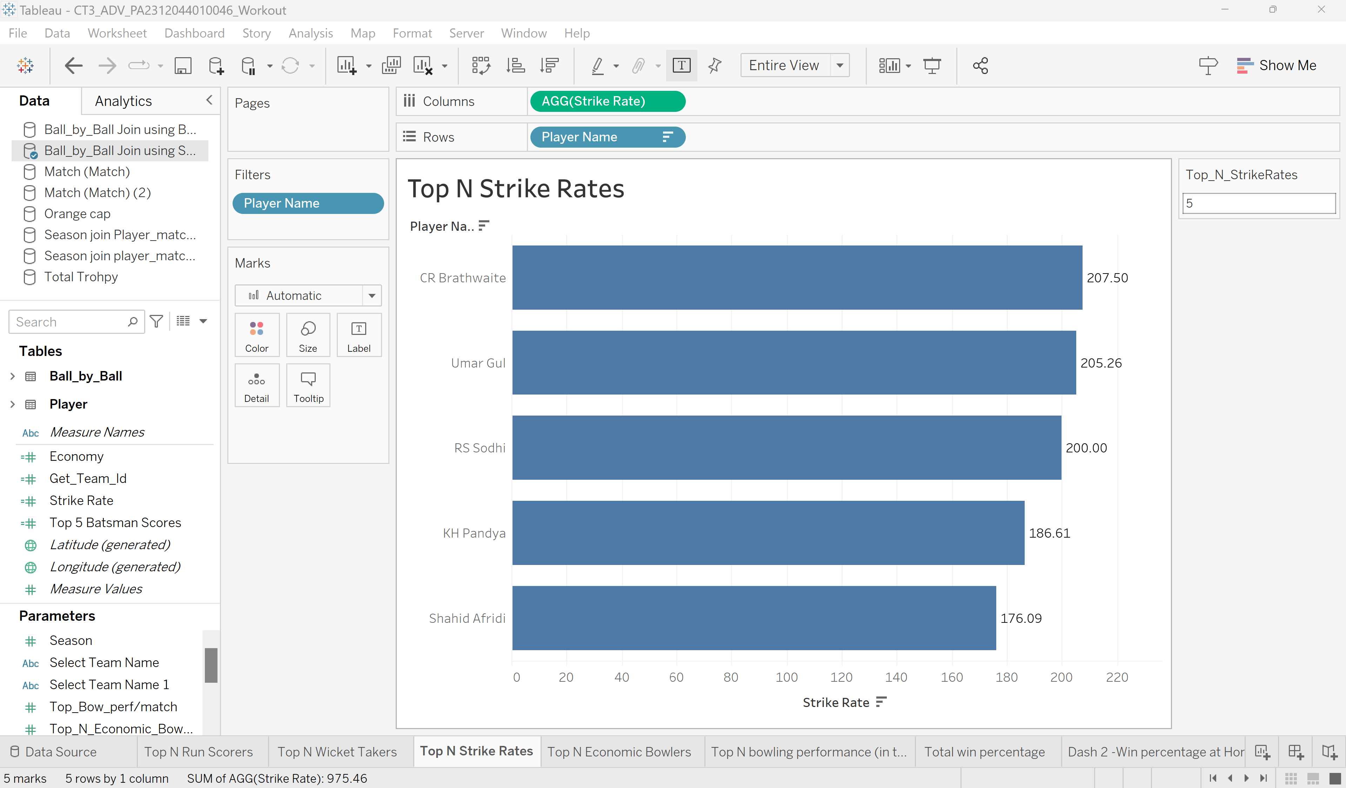
Tableau Dashboard and Parameters Control
Purpose: Display the top N strike raters in the IPL dataset.
Description: Using the parameter control can control the number of top strike raters to be displayed.

Slide 10
Conclusion
Insights: CR Brathwaite has the highest strike rate in IPL history, with 207.50 strikes.
The top strike raters have consistently performed well across multiple seasons.
Observations: Some players have consistently performed remarkably over multiple seasons like Umar Gul, RS Sodhi, KH Pandya,..

Slide 11
4. Top N Economic Bowlers
Purpose: Display the top N economic bowlers in the IPL dataset.
Description: This dashboard showcases the top N economic bowlers in the history of the Indian Premier League.
Introduction to the Tableau Sheet

Slide 12
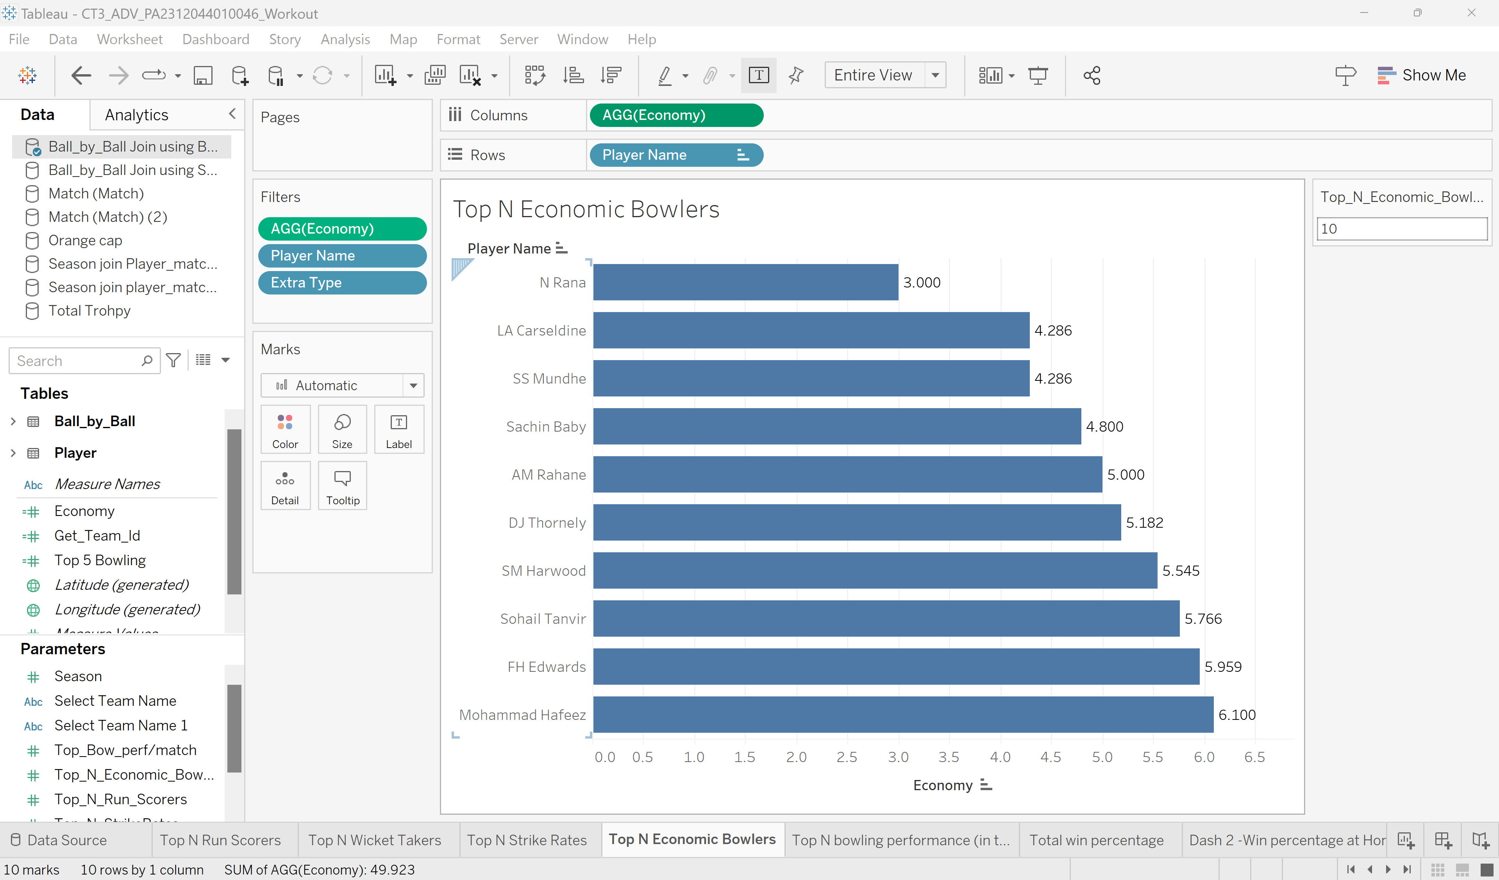
Tableau Dashboard and Parameters Control
Purpose: Display the top N strike raters in the IPL dataset.
Description: Using the parameter control can control the number of top strike raters to be displayed.

Slide 13
Conclusion
Insights: N Rana has the best economy bowling rate in IPL history, with an average of 3 runs per over.
The bowlers have consistently performed well across multiple seasons.
Observations: Some players, such as Carseldine, SS Mundhe, and Sachin Baby, have consistently performed remarkably over multiple seasons.

Slide 14
5. Top N Bowling Performance
Purpose: Display the top N bowling performance in the IPL dataset.
Description: This dashboard showcases the top N bowling performance in the history of the Indian Premier League.
Introduction to the Tableau Sheet

Slide 15
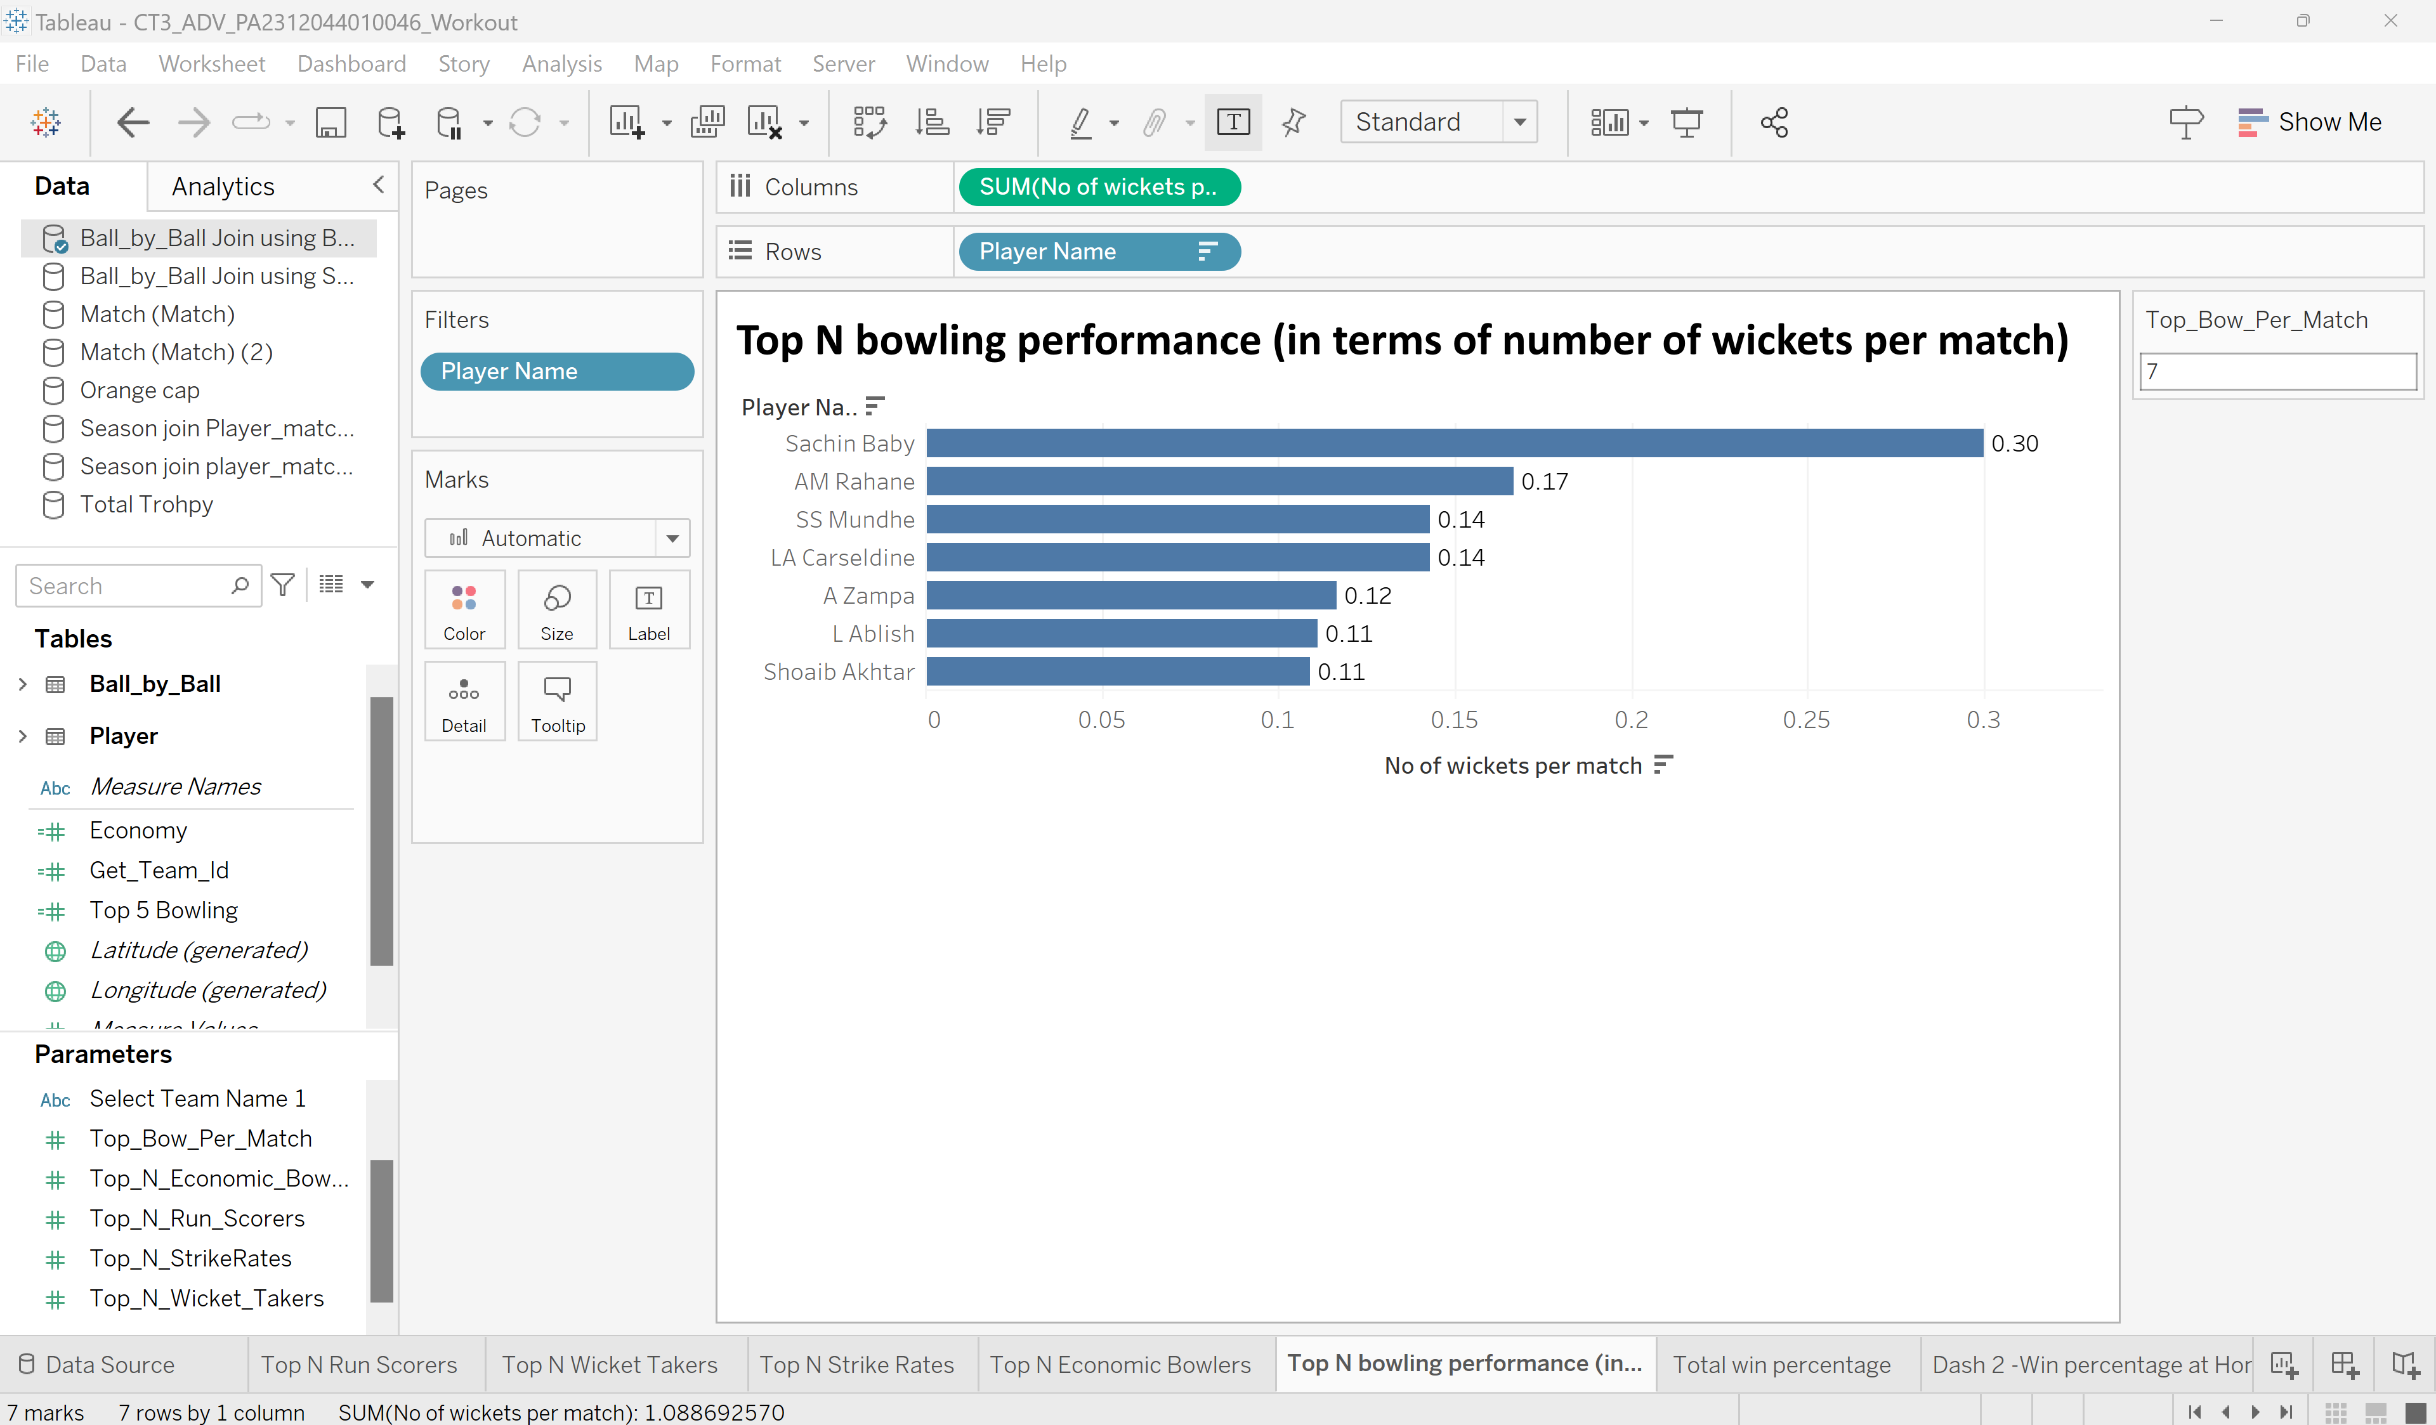
Tableau Dashboard and Parameters Control
Purpose: Display the top N bowling performance in terms of the number of wickets per match in the IPL dataset.
Description: Using the parameter control can control the number of top bowling performances in terms of the number of wickets per match, which has taken the total sum per player to be displayed.

Slide 16
Conclusion
Insights: Sachin Baby has the best bowling performance in IPL history, with 3 wickets per match.
The bowlers have consistently performed well across multiple seasons.
Observations: Some players, such as Rahane, SS Mundhe, and Carseldine, have consistently performed remarkably over multiple seasons.

Slide 17

6. Tableau dashboard to show each team in the IPL with the following findings:
Total Win Percentage
Win percentage at Home
Win percentage at Away
Top 5 batsmen and bowler
Number of trophies won
Number of Orange caps won
Number of Purple caps won

Slide 18
6. (a). Top Win Percentage
Purpose: Display the top win percentage by selected IPL Team.
Description: This dashboard showcases the total won percentage with the history of the Indian Premier League Team.
Introduction to the Tableau Sheet

Slide 19
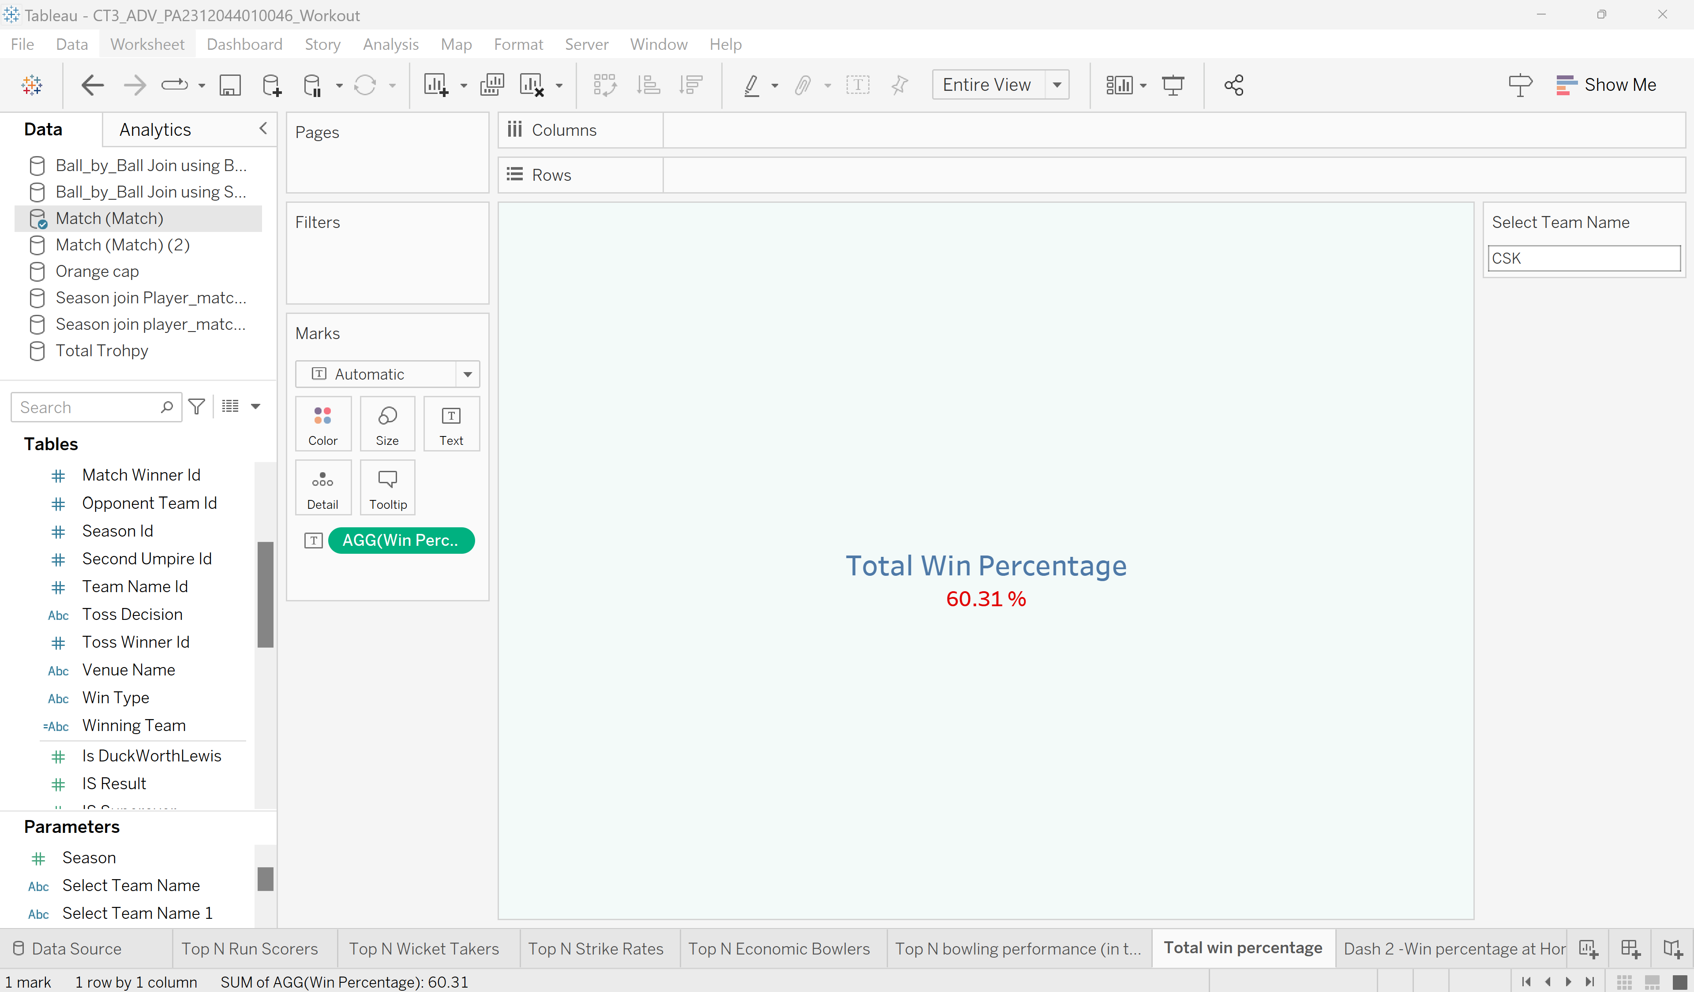
Parameter Control
Description: Using the parameter control can see the win percentage of the selected IPL team

Slide 20
Conclusion
Observations: Shows the win percentage in the dashboard to the respective IPL team

Slide 21
6. (b). Win Percentage at Home
Purpose: Display the win percentage at home by selected IPL Team.
Description: This dashboard showcases the won percentage at home with the history of the Indian Premier League Team.
Introduction to the Tableau Sheet

Slide 22
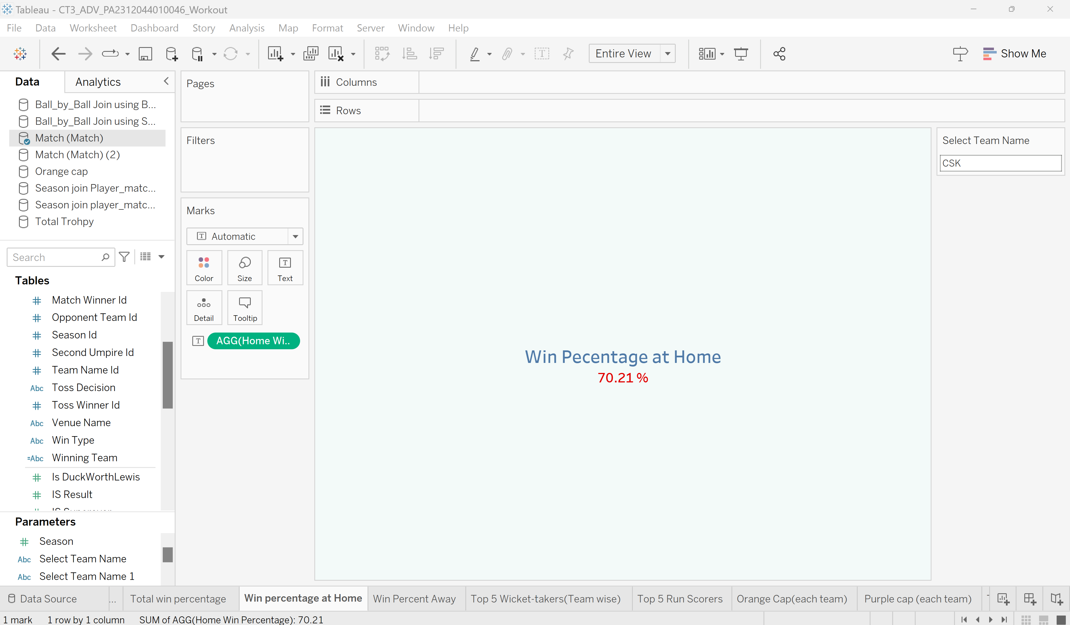
Parameter Control
Description: Using the parameter control, can see the win percentage at home of the selected IPL team

Slide 23
Conclusion
Observations: Shows the win percentage at home in the dashboard to the respective IPL team

Slide 24
6. (C). Win Percentage at Away
Purpose: Display the win percentage at away by selected IPL Team.
Description: This dashboard showcases the won percentage at away with the history of the Indian Premier League Team.
Introduction to the Tableau Sheet

Slide 25
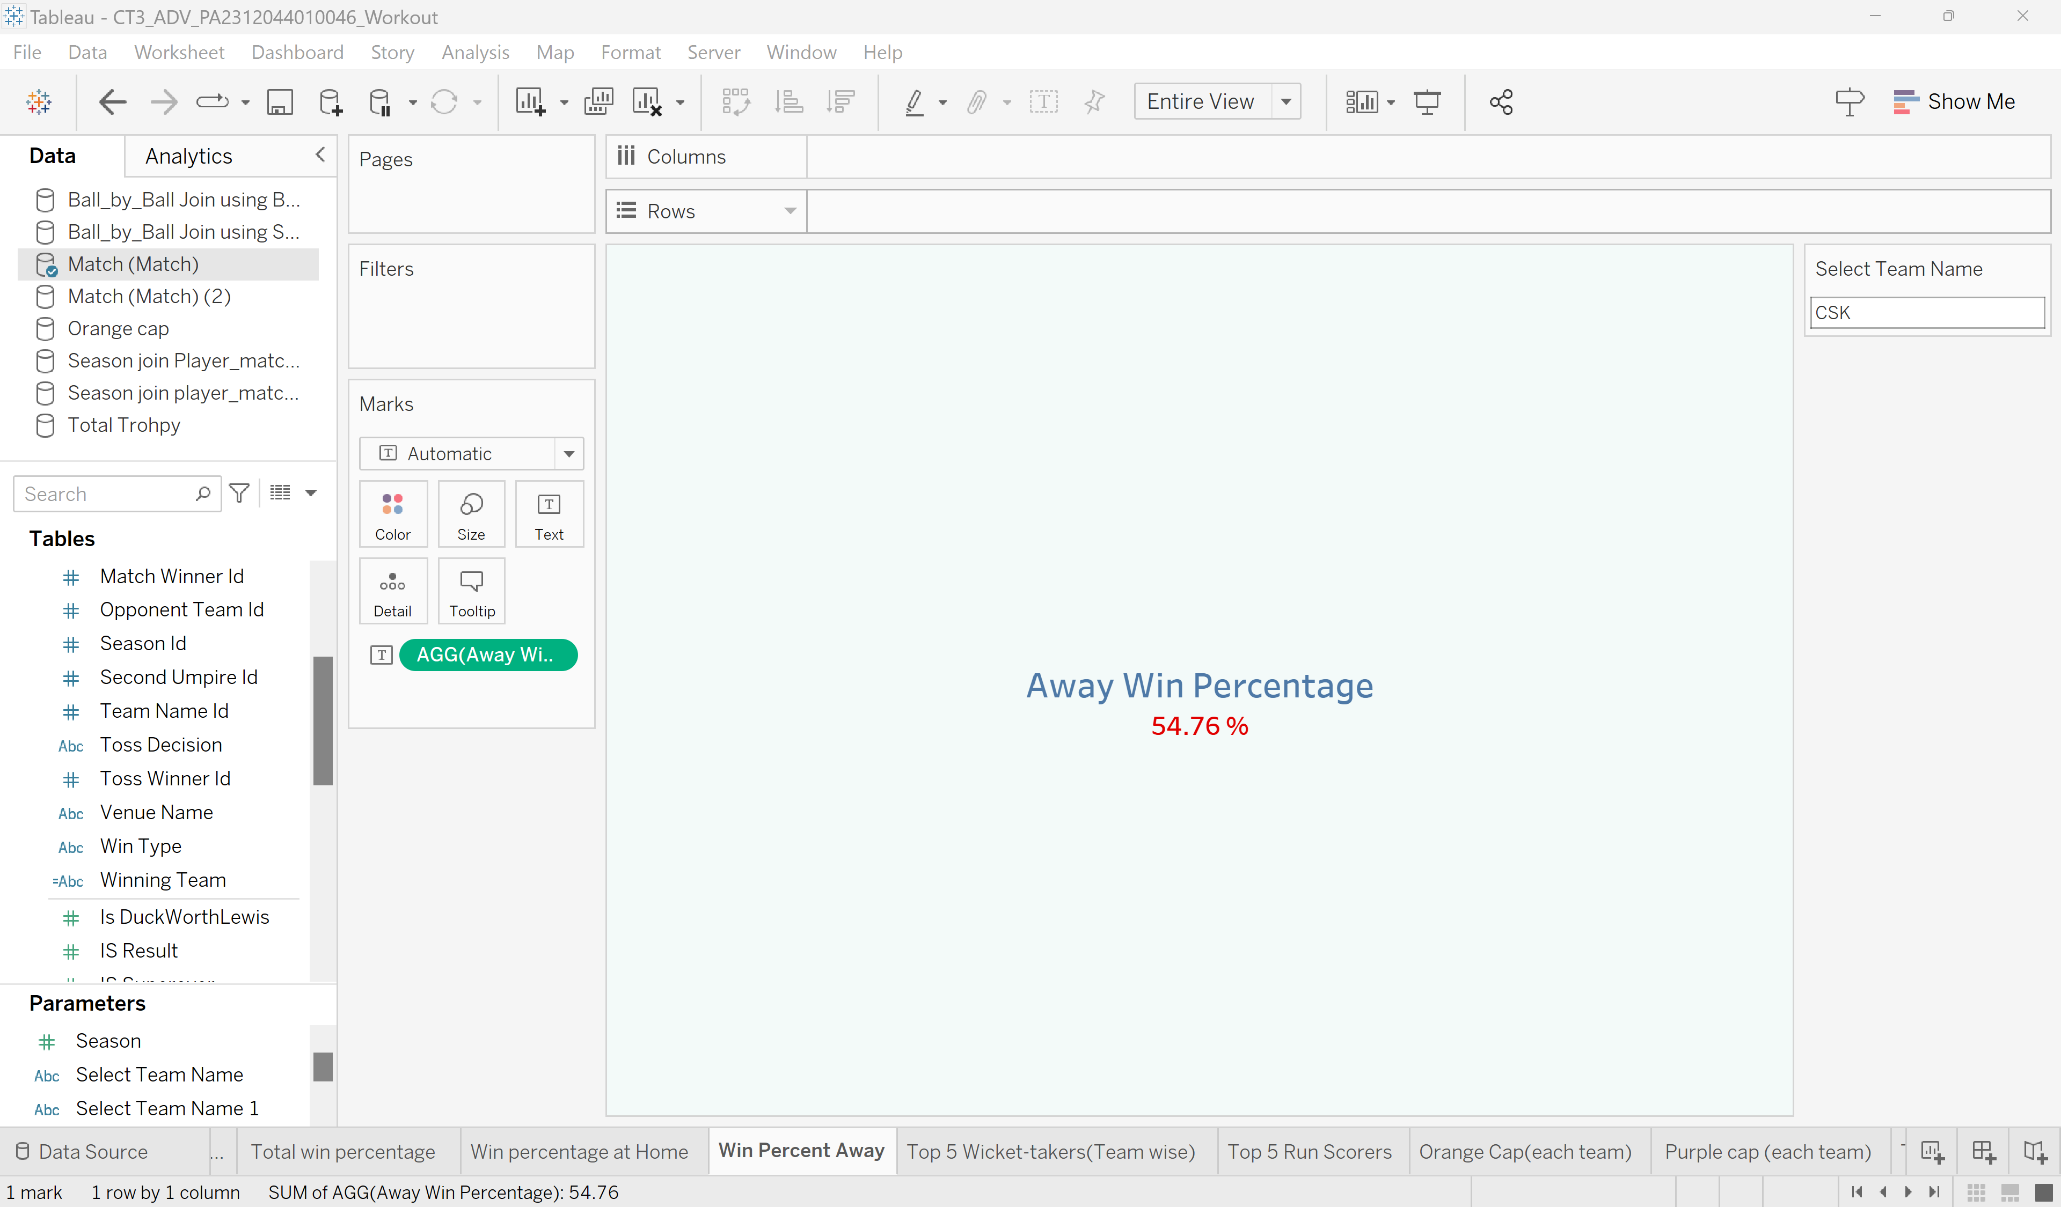
Parameter Control
Description: Using the parameter control, can see the win percentage at away of the selected IPL team

Slide 26
Conclusion
Observations: Shows the win percentage at away in the dashboard to the respective IPL team

Slide 27
6. (d). Top 5 Batsmen and Bowlers
Purpose: Display the top 5 batsmen and bowlers by selected IPL Team.
Description: This dashboard shows the top 5 batsmen and bowlers with the history of the Indian Premier League Team.
Introduction to the Tableau Sheet

Slide 28
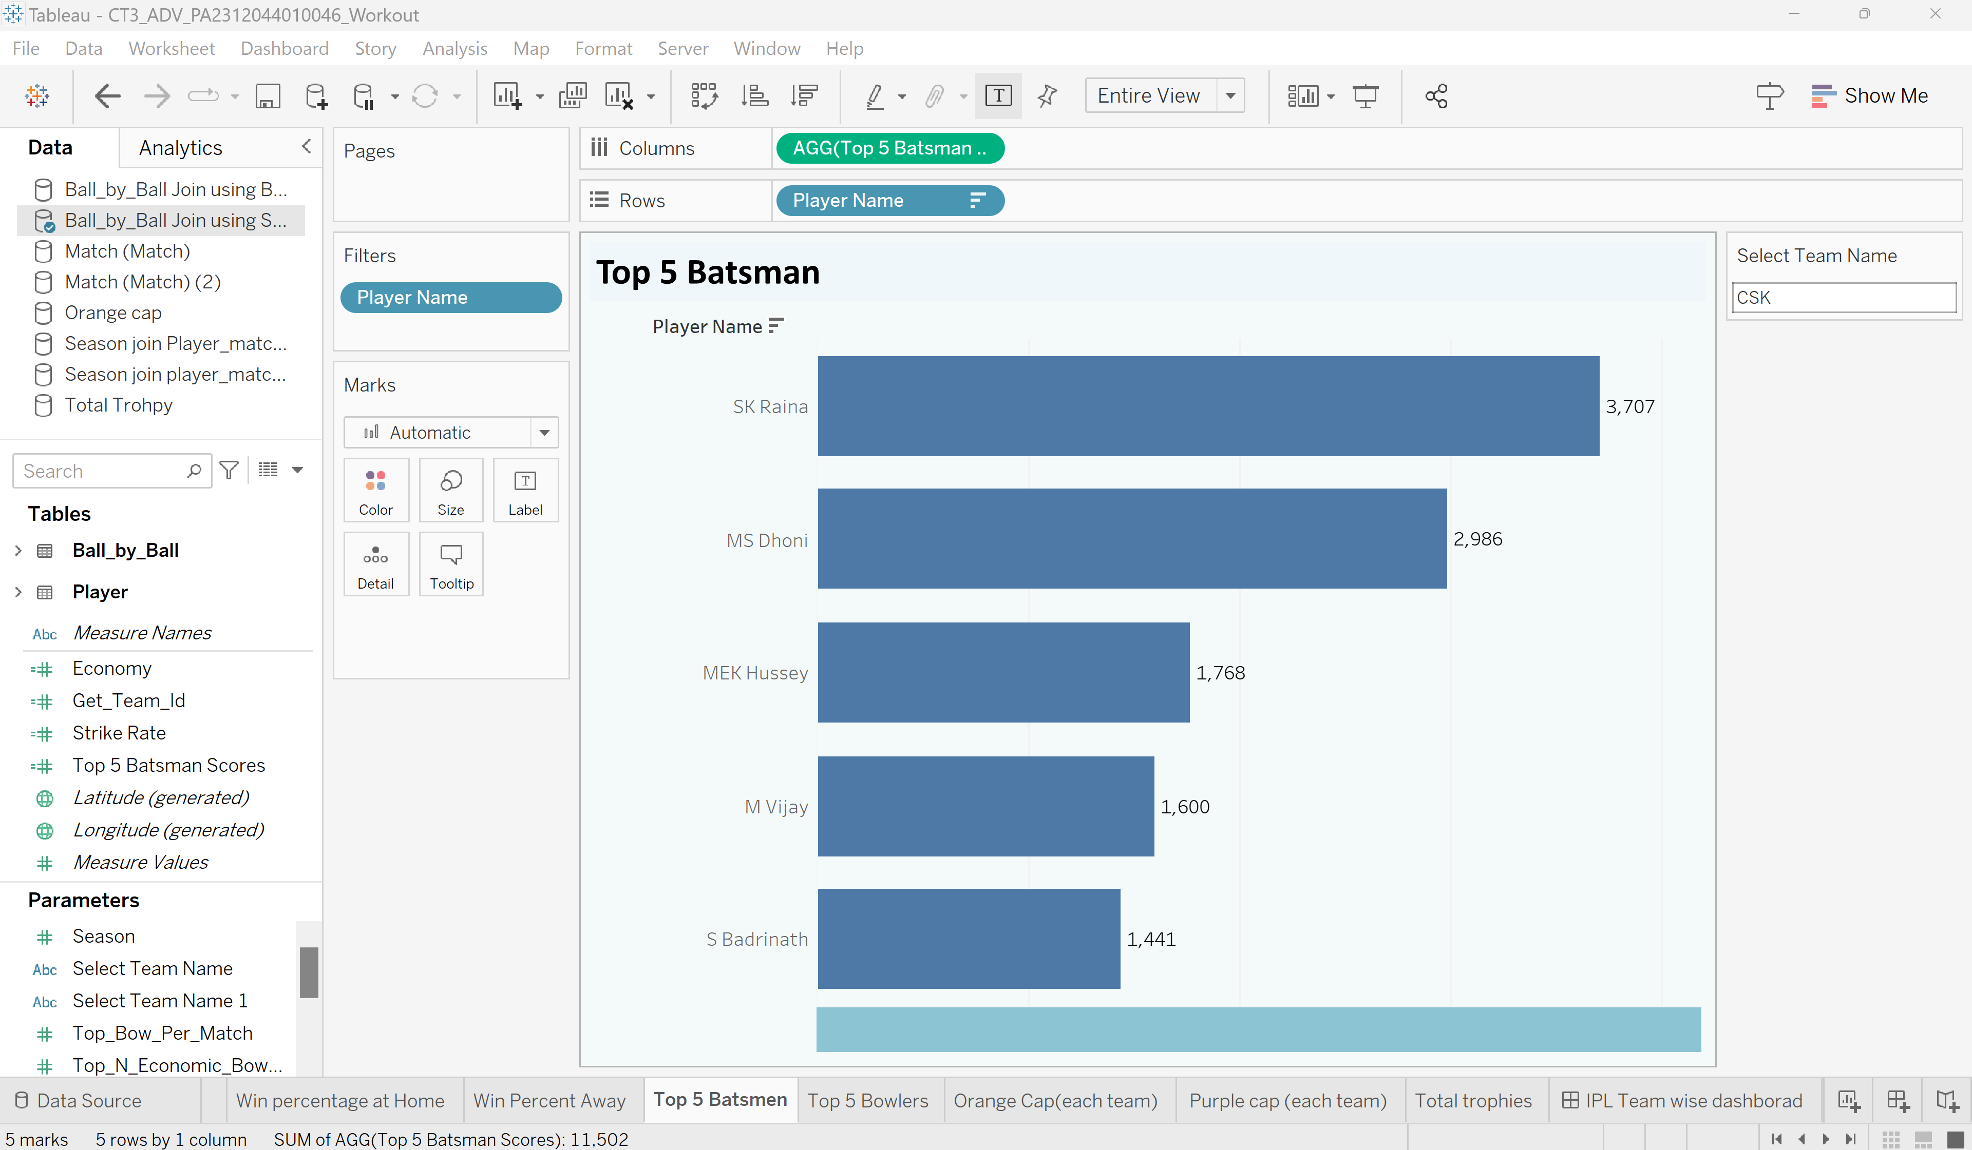
Parameter Control
Description: Using the parameter control, will see the top 5 batsmen of the selected IPL team

Slide 29
Conclusion
Observations: Shows the top 5 batsmen in the dashboard to the respective IPL team

Slide 30
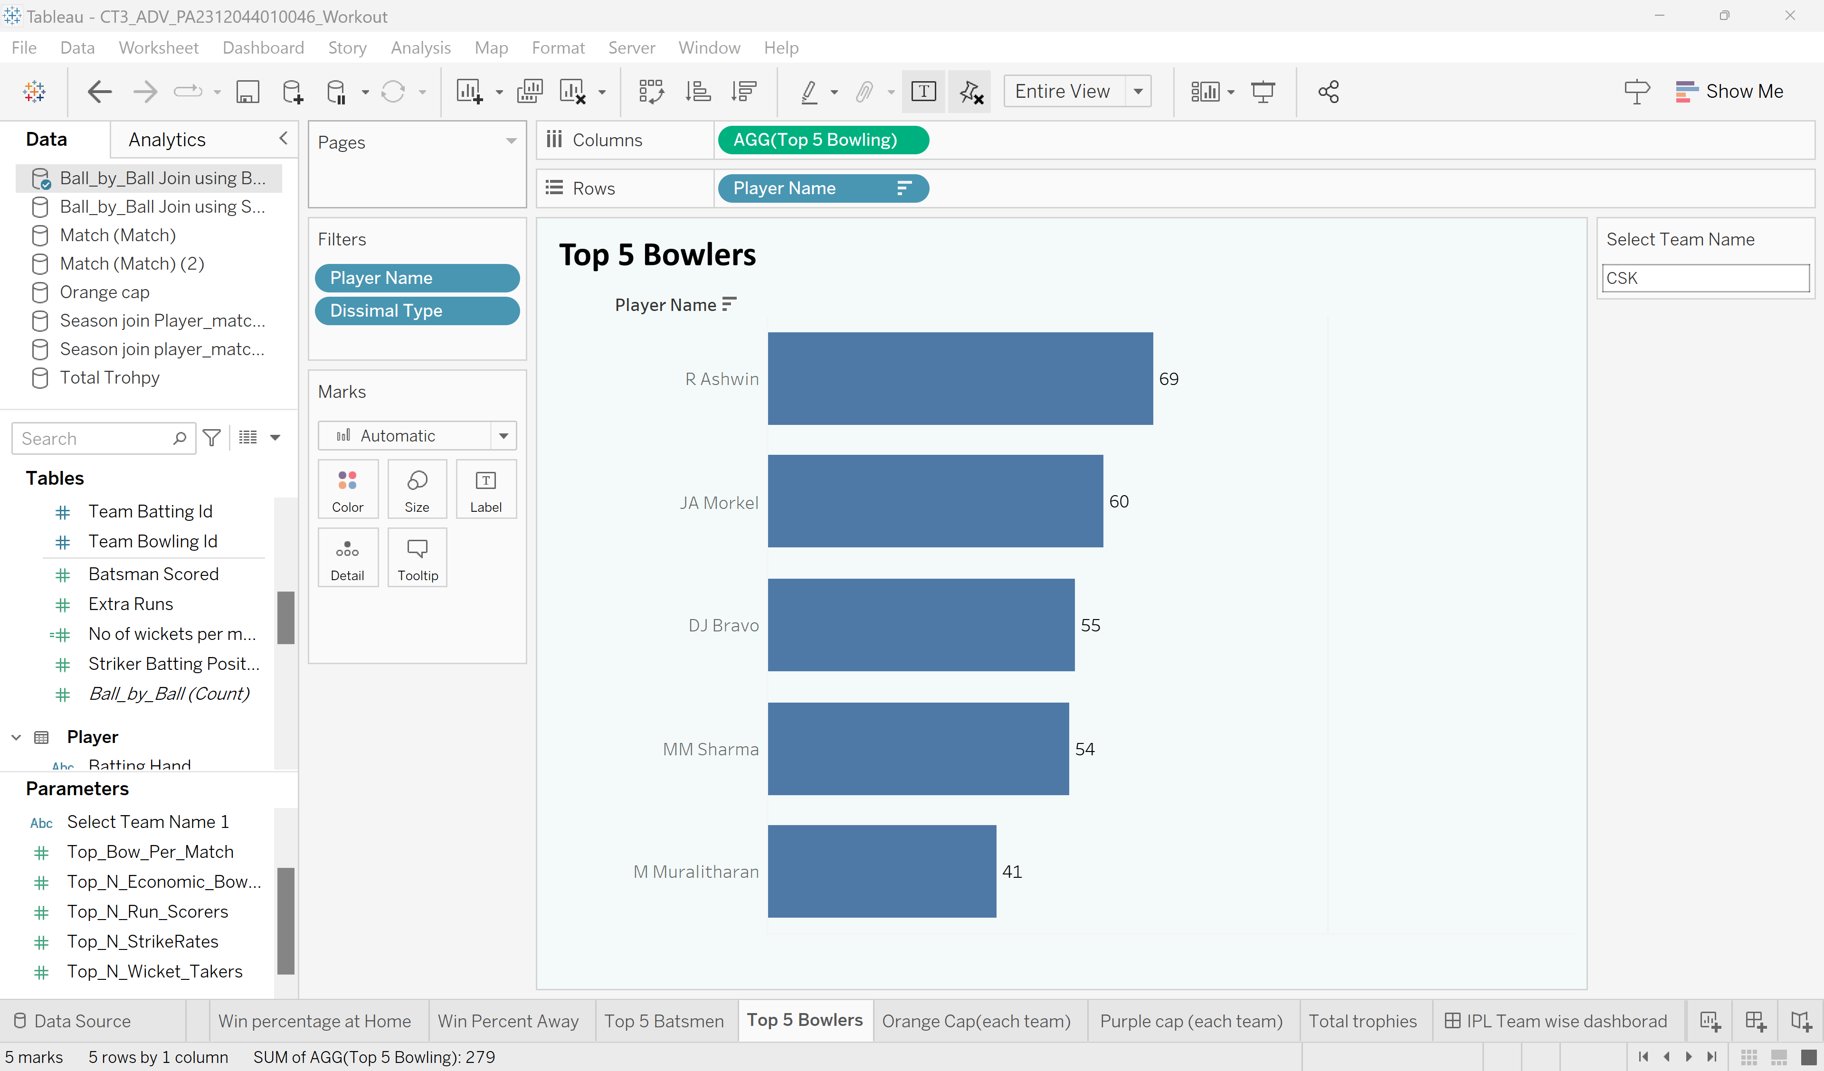
Parameter Control
Description: Using the parameter control, will see the top 5 bowlers of the selected IPL team

Slide 31
Conclusion
Observations: Shows the top 5 bowlers in the dashboard to the respective IPL team

Slide 32
6. (e). Number of Trophies Won
Purpose: Display the number of trophies won by selected IPL Team.
Description: This dashboard shows the number of trophies won with the history of the Indian Premier League Team.
Introduction to the Tableau Sheet

Slide 33
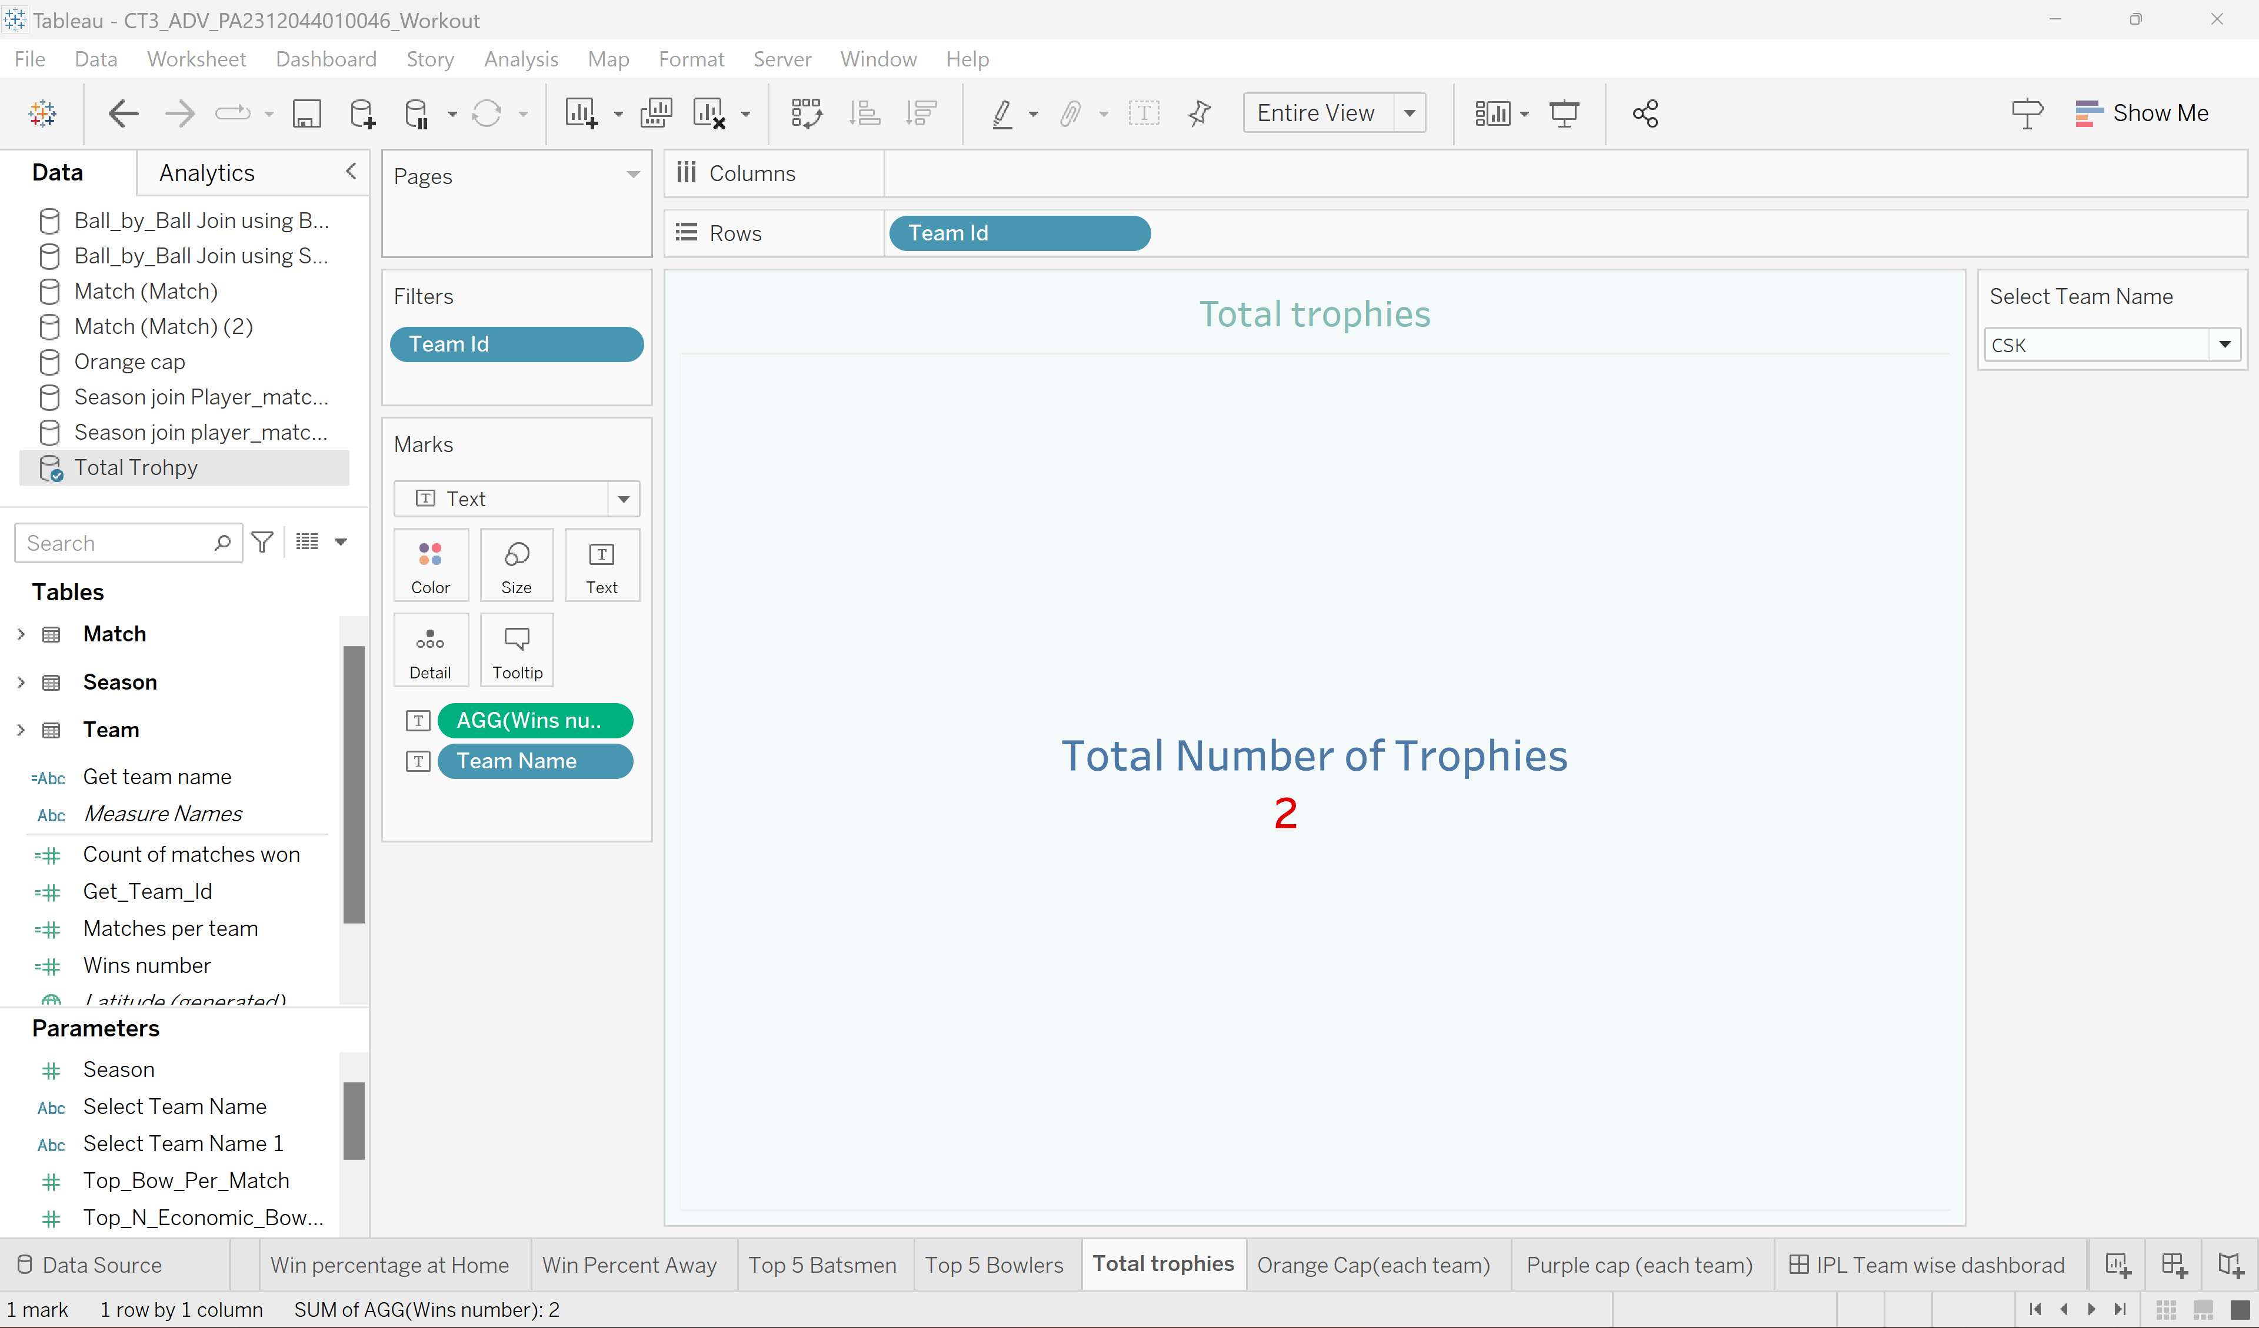
Parameter Control
Description: Using the parameter control, show the total number trophies won by selected IPL team

Slide 34
Conclusion
Observations: Shows the number of trophies won in the dashboard to the respective IPL team

Slide 35
6. (f). Number of Orange and Purple Cap Won
Purpose: Display the number of Orange and Purple caps for the selected IPL Team.
Description: This dashboard shows the number of orange and purple caps won with the history of the Indian Premier League Team.
Introduction to the Tableau Sheet

Slide 36
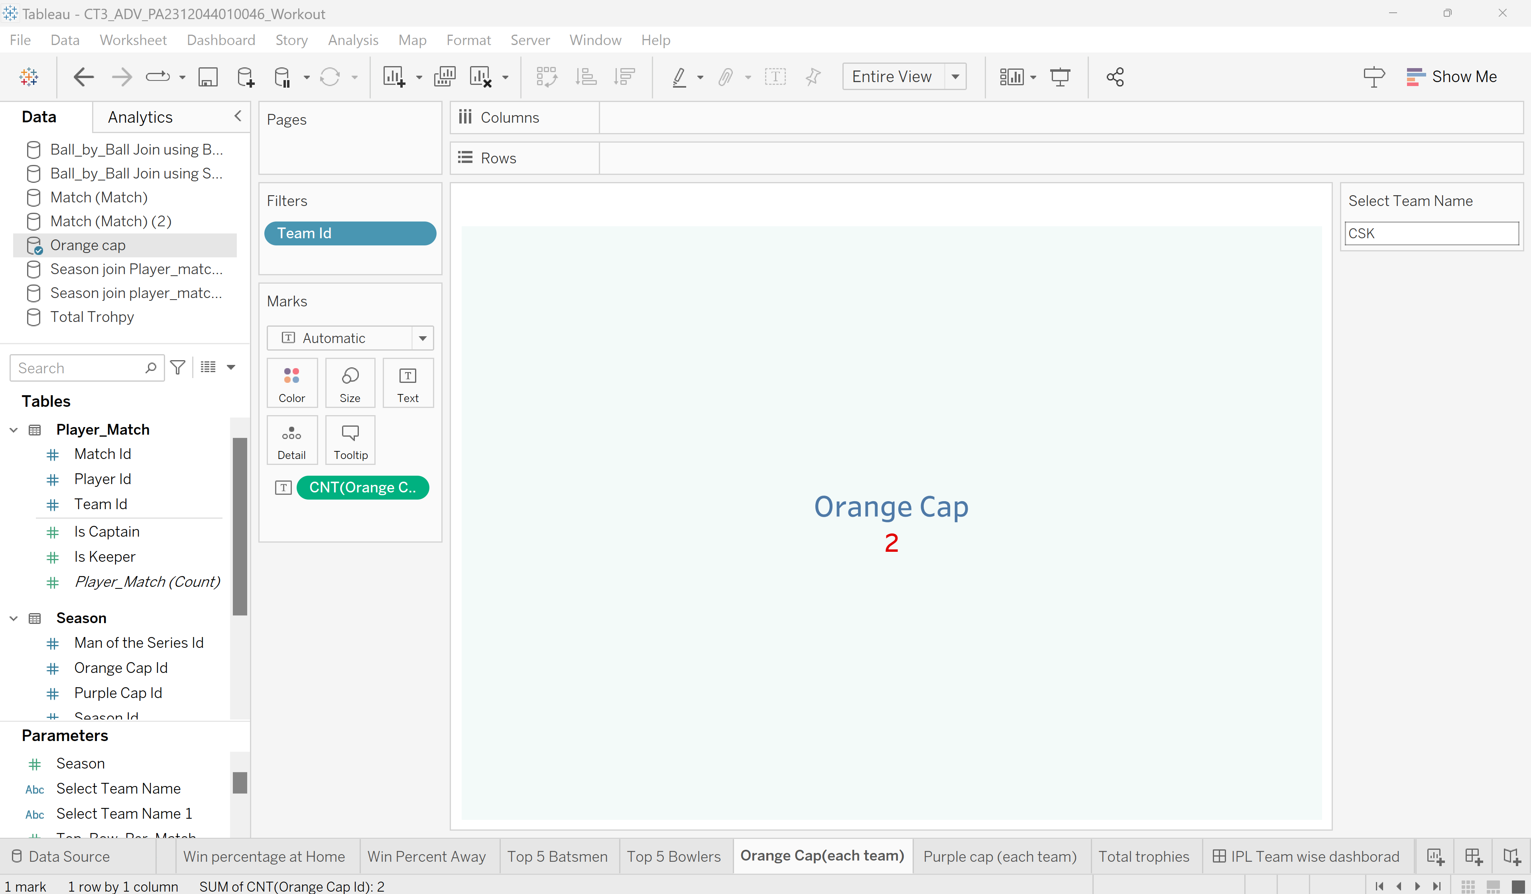
Parameter Control
Description: Using the parameter control, show the number of orange caps won by selected IPL team

Slide 37
Conclusion
Observations: Shows the number of Orange caps won in the dashboard to the respective IPL team

Slide 38
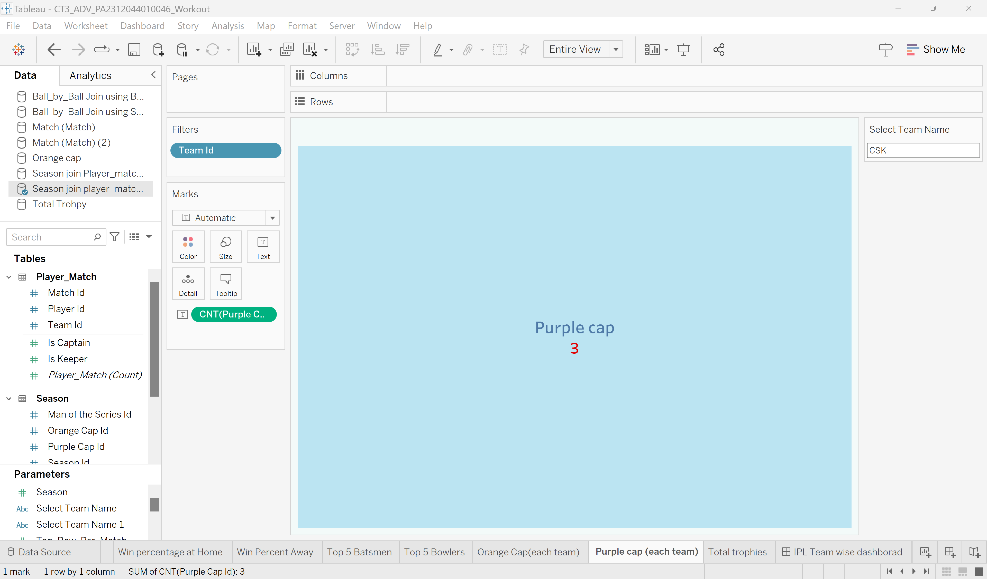
Parameter Control
Description: Using the parameter control, show the number of purple caps won by selected IPL team

Slide 39
Conclusion
Observations: Shows the number of purple caps won in the dashboard to the respective IPL team

Slide 40
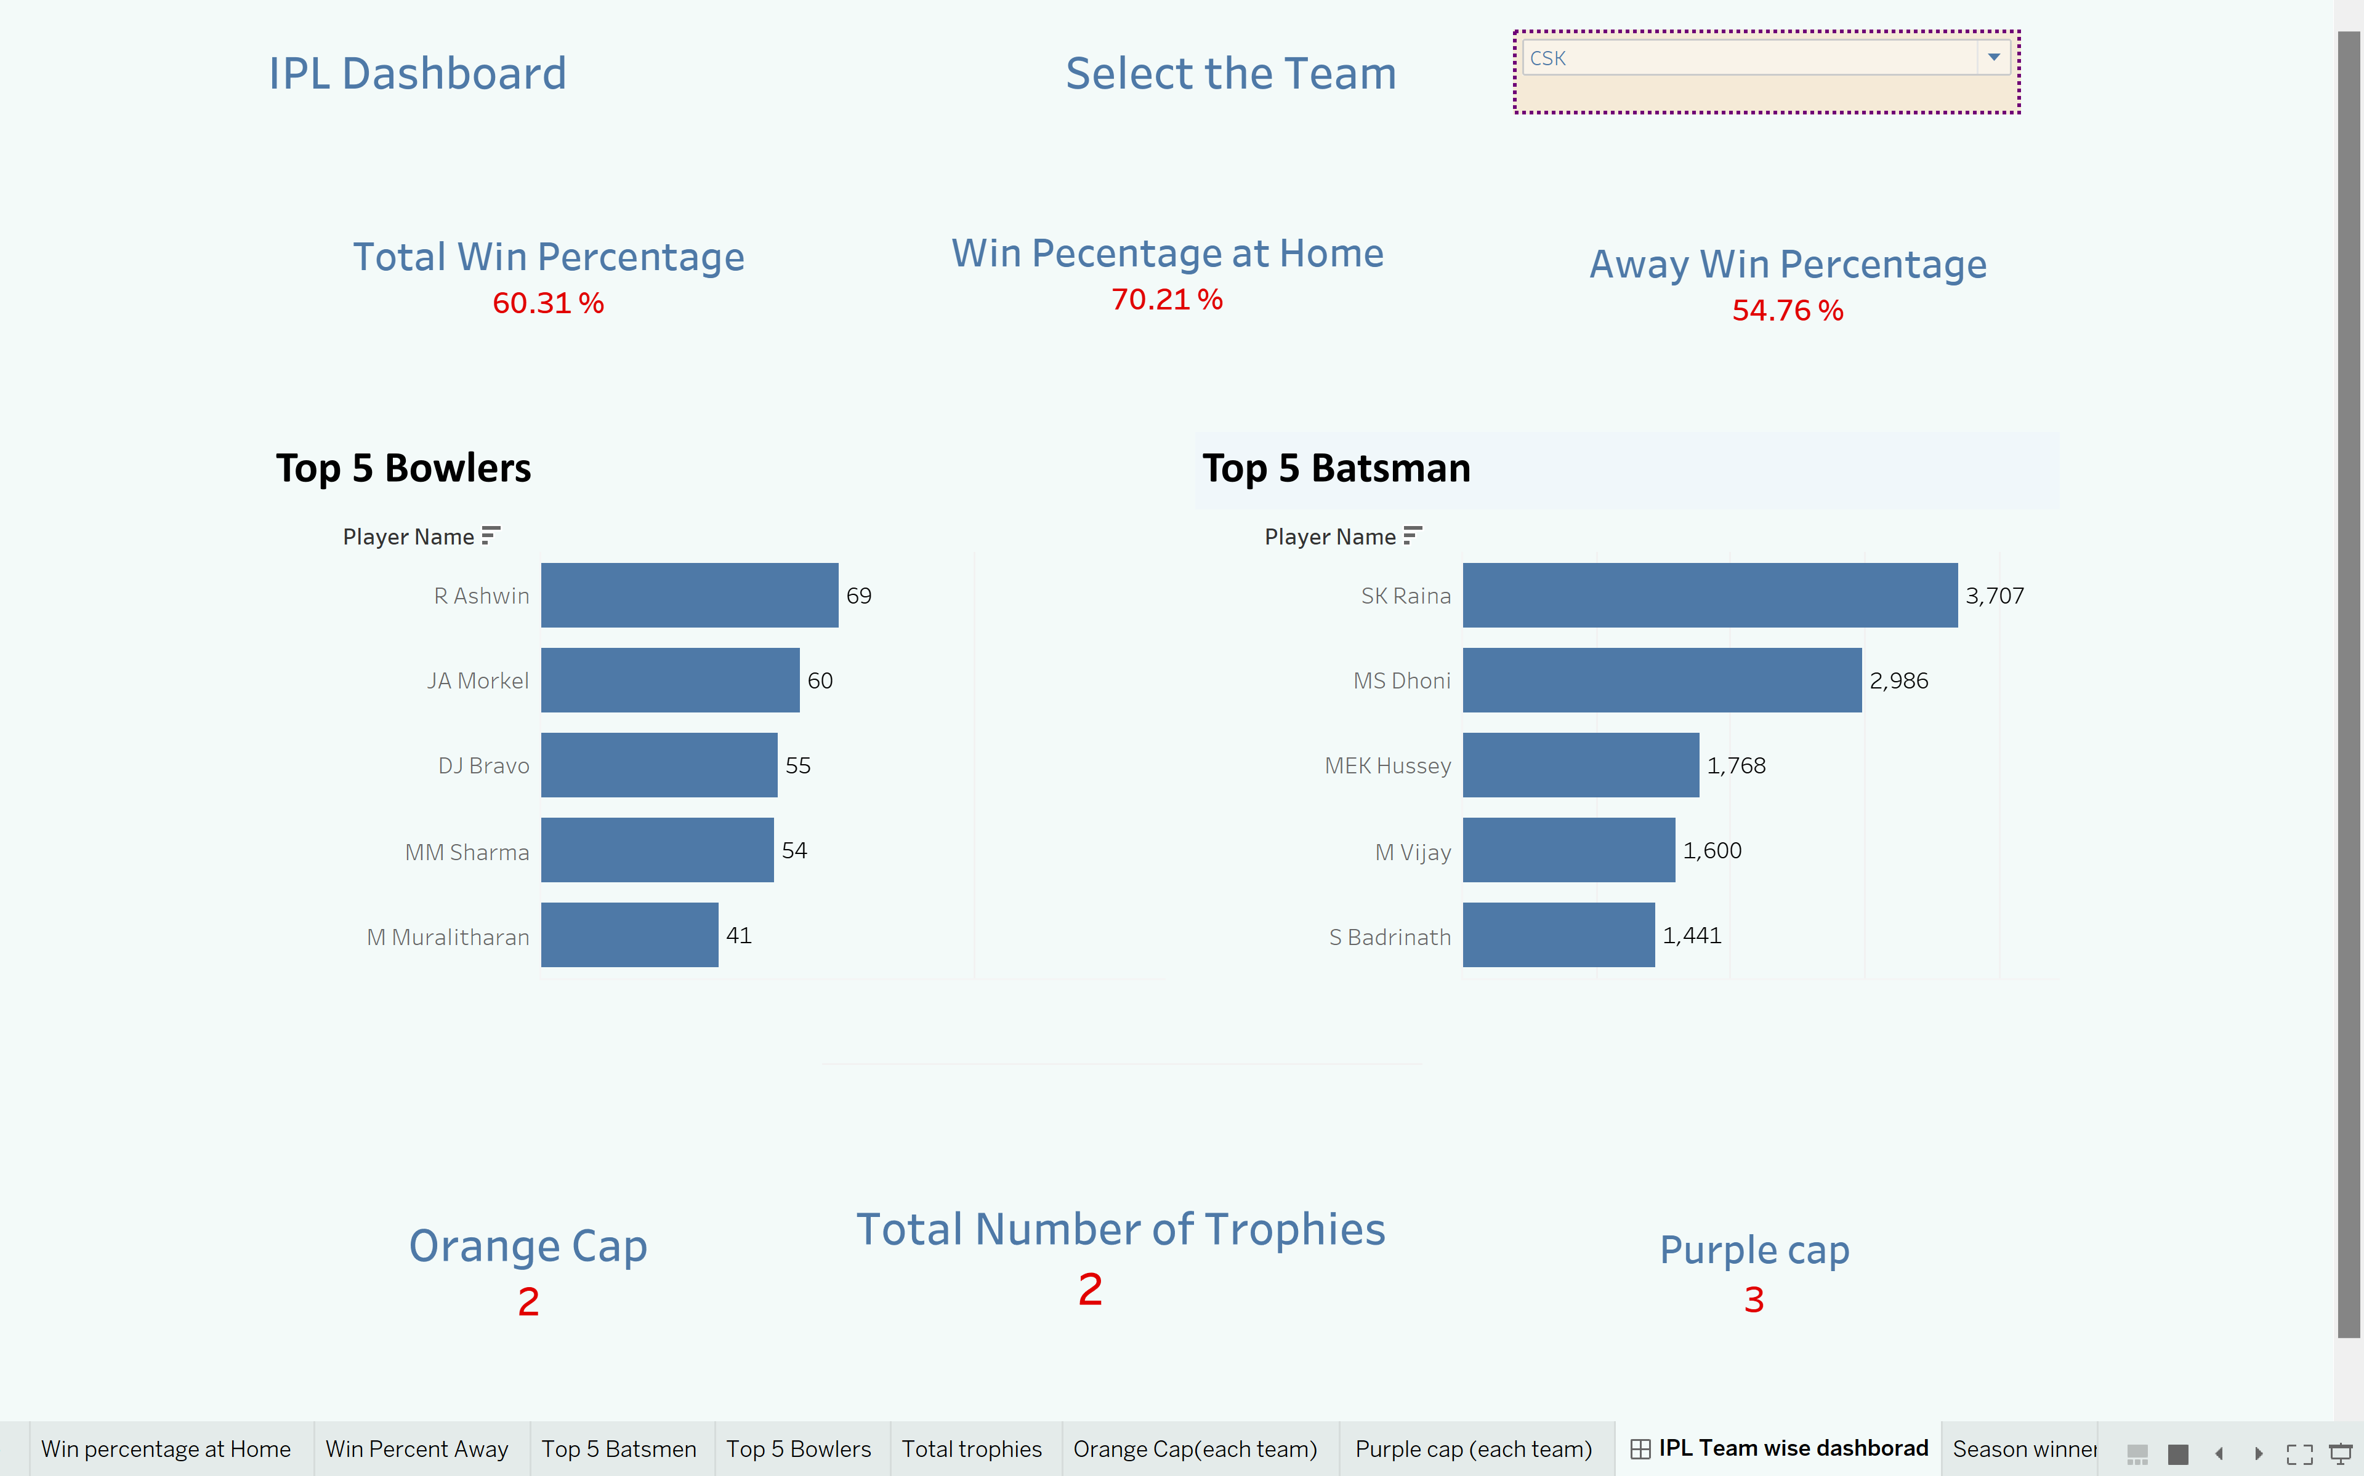
6. Tableau Dashboard for the IPL Team
Purpose: Display key performance metrics for the selected Team in the Indian Premier League (IPL) and provide insights into the team's performance both at home and away, top performers, and achievements
Description: This dashboard provides a detailed analysis of [Team Name]'s performance in the IPL. It includes metrics such as total win percentage, win percentage at home and away, top 5 batsmen and bowler, number of trophies won, and number of Orange and Purple caps won.

Slide 41
Conclusion: Achievements: The team has achieved IPL trophies, reflecting its strong presence in the tournament.

Slide 42
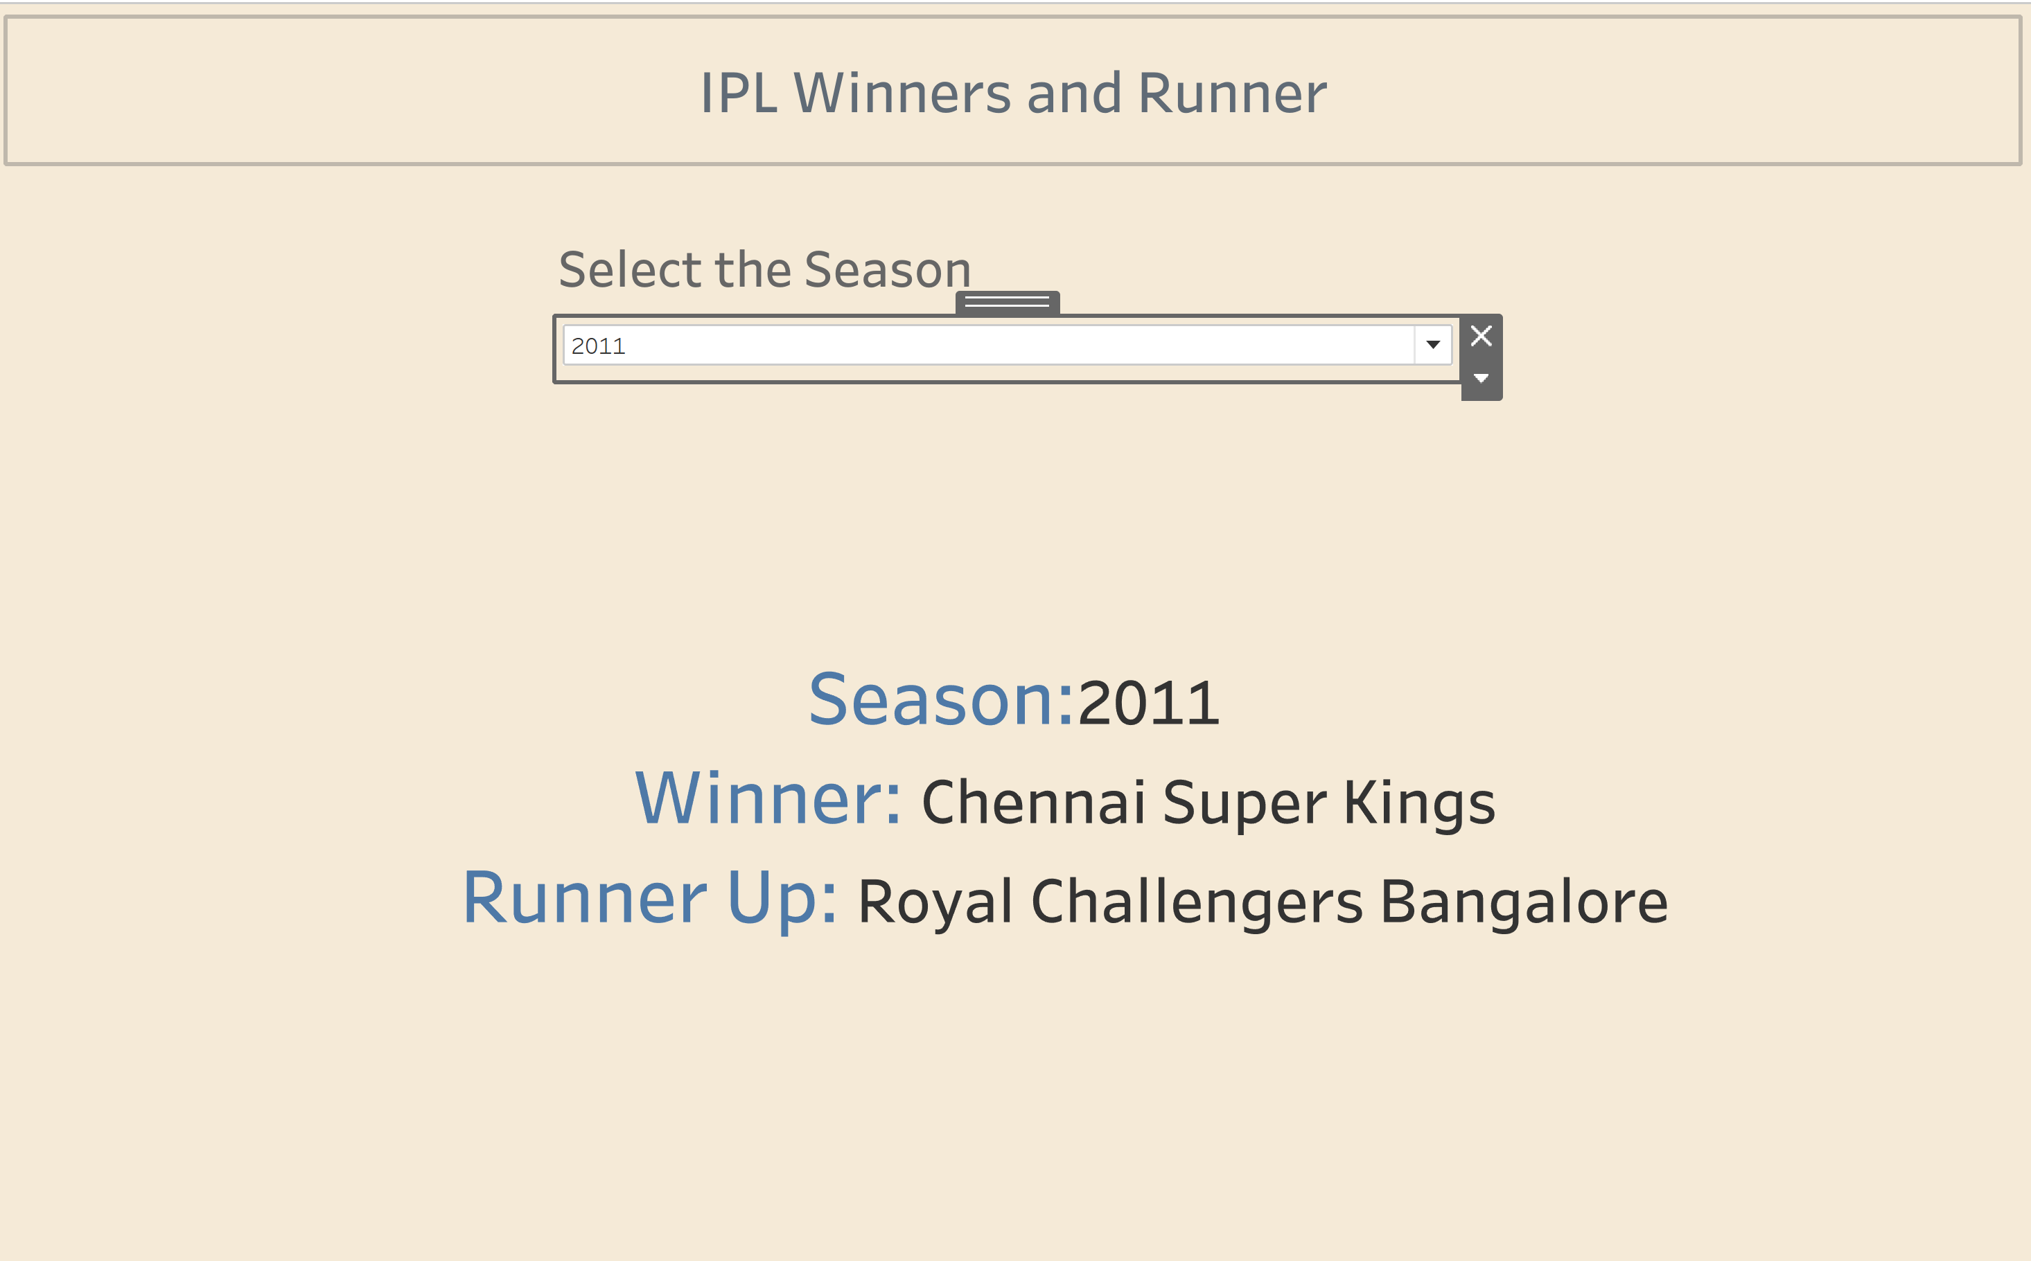
7. Tableau Dashboard for the winners and runners up for all the seasons
Purpose: Display the winners and runners-up of all IPL seasons and provide an overview of the most successful teams in IPL history.
Description: This dashboard showcases the winners and runners-up of all IPL seasons and provides insights into the most successful teams in the league's history.

Slide 43
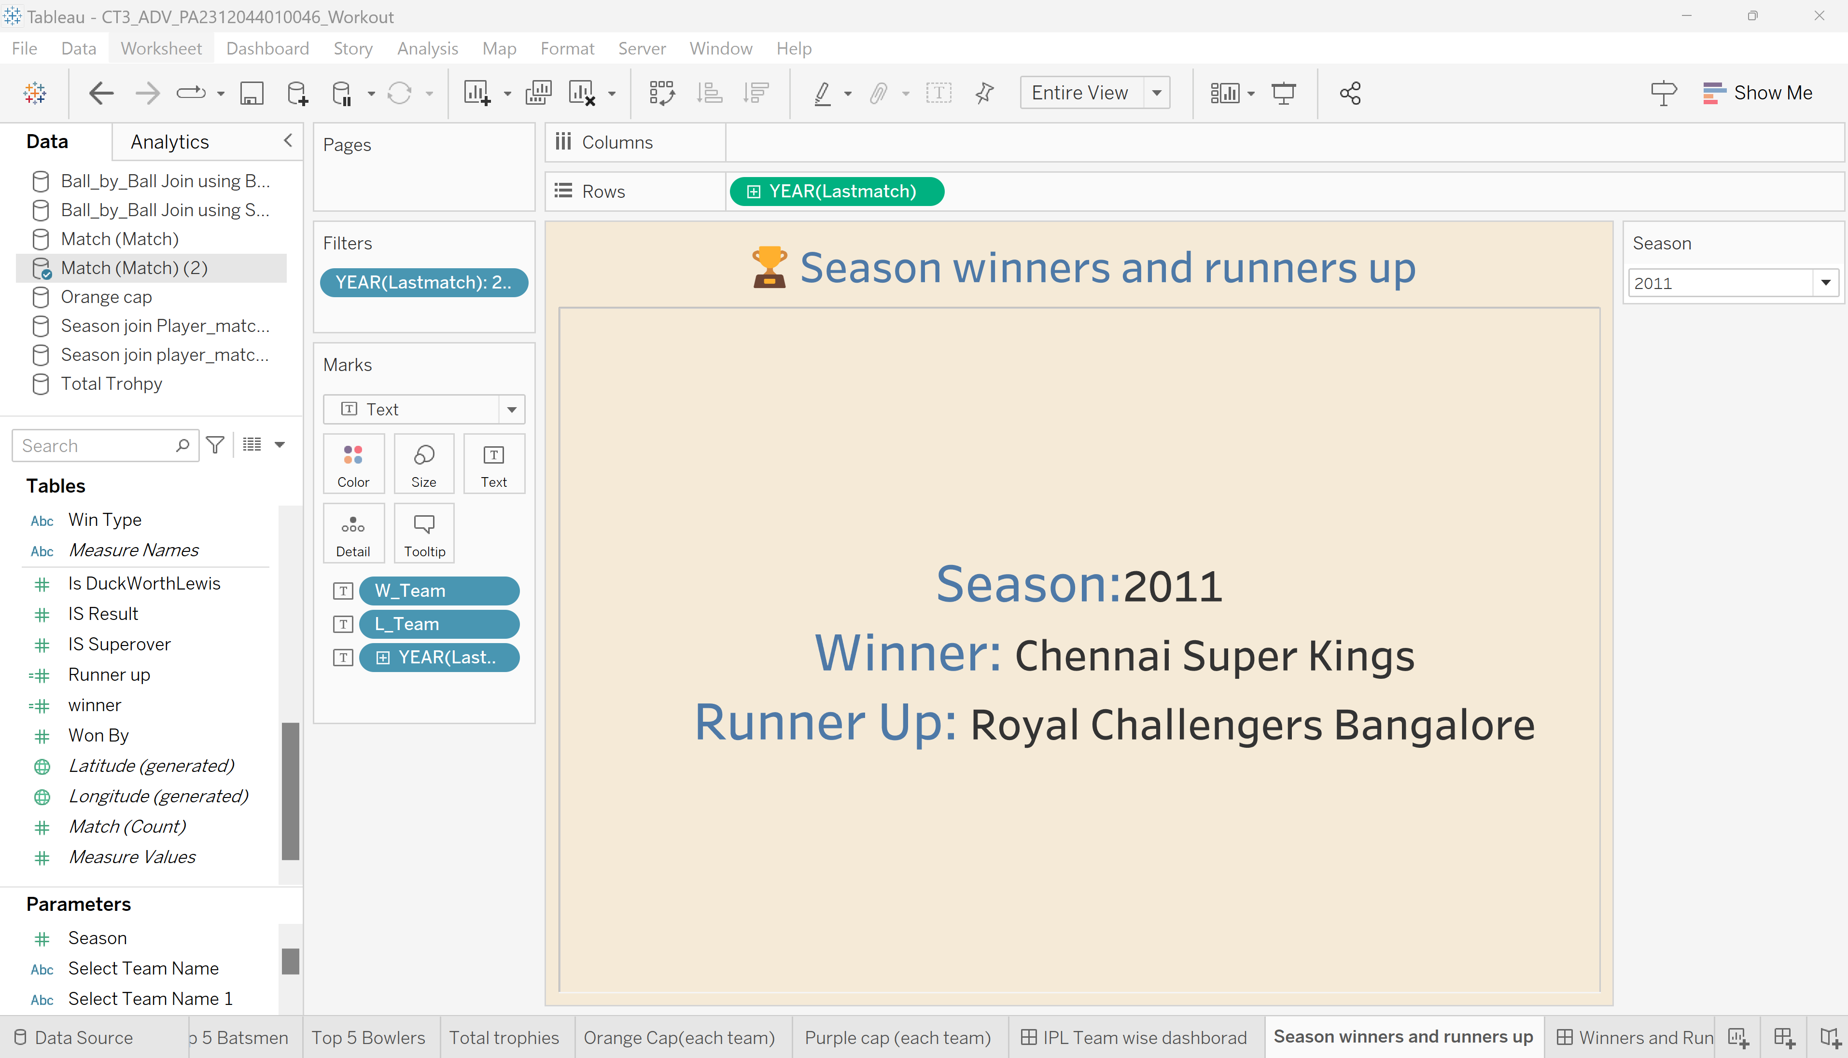

Slide 44
Conclusion: Achievements: The team has achieved tournament.

Slide 45
Thank You

